Slide 1
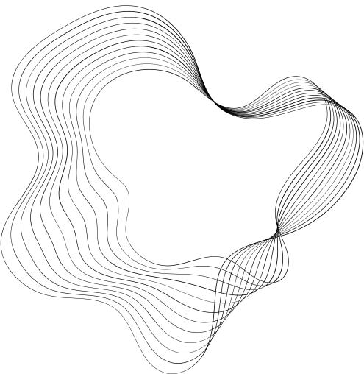

INVESTIGATING S-BOX ALTERATIONS
WITH THE HELP OF LSTM MODEL
PRESENTED BY VASU SHARMA AND RONIT SAINI

Slide 2
PROJECT GOALS
Explore Cryptographic Implications:
Investigate the effects of S-box modifications on cryptographic strength and vulnerabilities in the PRESENT cipher.
Evaluate Machine Learning Performance:
Assess how these modifications affect an LSTM model's ability to predict plaintext from ciphertext.

Slide 3

BACKGROUND ON PRESENT CIPHER AND
S-BOX
Overview of the PRESENT Cipher:
Designed for lightweight applications
The PRESENT cipher uses an S-box to enhance security by substituting bits during encryption.
Importance of the S-box:
The S-box's design directly affects the cipher's resistance against attacks and overall cryptographic strength.

Slide 4





MOTIVATION FOR MODIFYING THE S-BOX
By modifying the S-box, we aim to assess its impact on both cryptographic security and the predictive accuracy of machine learning models.
2. Understanding these impacts can lead to insights into potential vulnerabilities and improvements in cryptographic protocols.

Slide 5


METHODOLOGY OVERVIEW
Dataset Creation:
Two datasets were created: one with plaintext-ciphertext pairs using the original S-box and another with a modified S-box configuration.
LSTM Model :
An LSTM neural network was employed to learn patterns from the datasets and predict plaintext bits from ciphertext bits.

Slide 6

DATASET CREATION PROCESS
Original S-box Dataset:
Used the standard PRESENT cipher configuration with the default S-box.
Generated plaintext-ciphertext pairs using the original S-box.
Each pair consists of a plaintext message and its corresponding ciphertext encrypted using the original S-box.
Saved the dataset to a CSV file (dataset_normal_sbox.csv).
Modified S-box Dataset:
Implemented a custom-modified S-box configuration for the PRESENT cipher.
Generated plaintext-ciphertext pairs using the modified S-box configuration.
Each pair includes a plaintext message and its corresponding ciphertext encrypted using the modified S-box.
Saved the dataset to a CSV file (dataset_changed_sbox.csv).

Slide 7
LSTM MODEL ARCHITECTURE
LSTM Model Overview:
The LSTM (Long Short-Term Memory) model was chosen for its ability to capture long-term dependencies in sequential data, making it suitable for cryptographic analysis.
Architecture: A single LSTM layer with 64 units was employed, followed by a dense layer with 64 units and a sigmoid activation function.
Input Data Format:
Input Shape: Data was formatted into (batch_size, timesteps, features) for compatibility with LSTM input requirements.
Each ciphertext input (sequence) was fed sequentially to the LSTM layer to predict corresponding plaintext.

Slide 8
TRAINING PROCESS AND DATA PARTITIONING
Data Partitioning:
Two datasets prepared: One with original S-box (dataset_normal_sbox.csv) and another with modified S-box (dataset_changed_sbox.csv).
Training Set: 80,000 samples for model training.
Validation Set: 10,000 samples for hyperparameter tuning and validation.
Test Set: 10,000 samples for final model evaluation.
Training Process:
Model: Single-layer LSTM (64 units) followed by a dense layer (64 units, sigmoid activation).
Optimizer: Adam optimizer for gradient descent.
Loss Function: Binary Cross entropy.
Metrics: Accuracy for monitoring training progress.

Slide 9
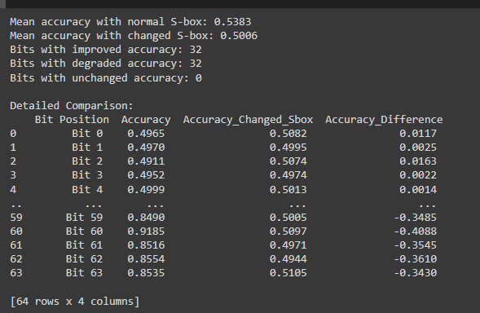
EVALUATION AND RESULTS
Model Performance Comparison:
Mean Accuracy:
Original S-box: 53.83%
Modified S-box: 50.06%
Bit-wise Accuracy Comparison:
Detailed comparison of accuracy for each
bit position.
Improved Bits: 32
Degraded Bits: 32
Unchanged Bits: 0
Significant Findings:
Overall Performance:
LSTM model performed worse with the modified S-box compared to the original S-box.
Detailed Bit-wise Analysis:
Changes in accuracy for each bit position highlight the impact of S-box modification on cryptographic analysis.

Slide 10
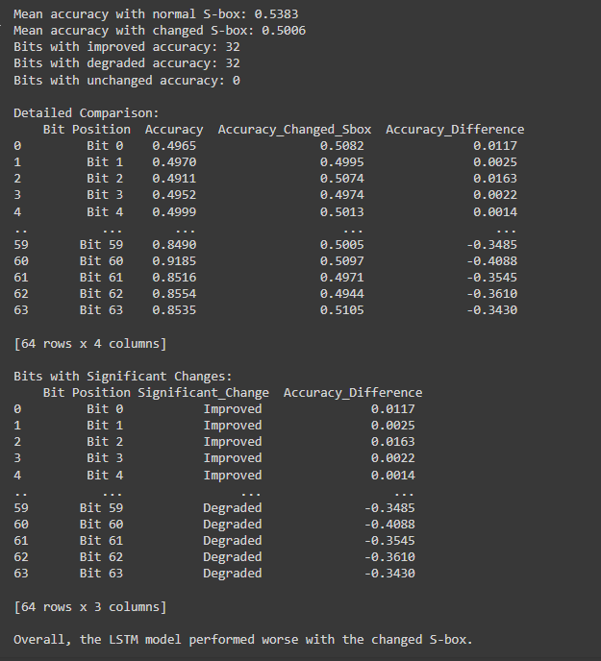

CONCLUSION
Bit-wise analysis showed that while 32 bits saw improved accuracy, 32 bits experienced degradation, highlighting the nuanced impact of S-box modifications.
Modifying the S-box in the PRESENT cipher significantly impacts both cryptographic security and the predictive accuracy of machine learning models.
Our study revealed a decrease in overall model performance when using a modified S-box, with a mean accuracy drop from 53.83% to 50.06%.
Insights gained from this study can inform future research in cryptography and machine learning, emphasizing the need for robust evaluation frameworks when introducing changes to cryptographic protocols.

Slide 11




FUTURE DIRECTIONS
Investigate further optimizations or variations in S-box design to enhance both security and model performance.
Explore additional machine learning techniques to mitigate the impact of S-box modifications on predictive accuracy.
Collaborate with cryptographic experts to integrate findings into practical security assessments and protocol designs.

Slide 12
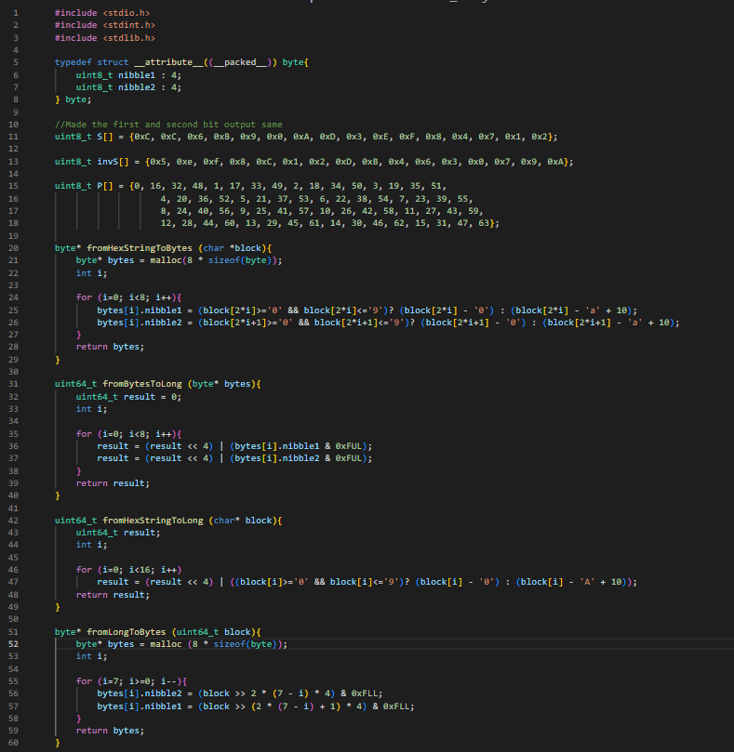
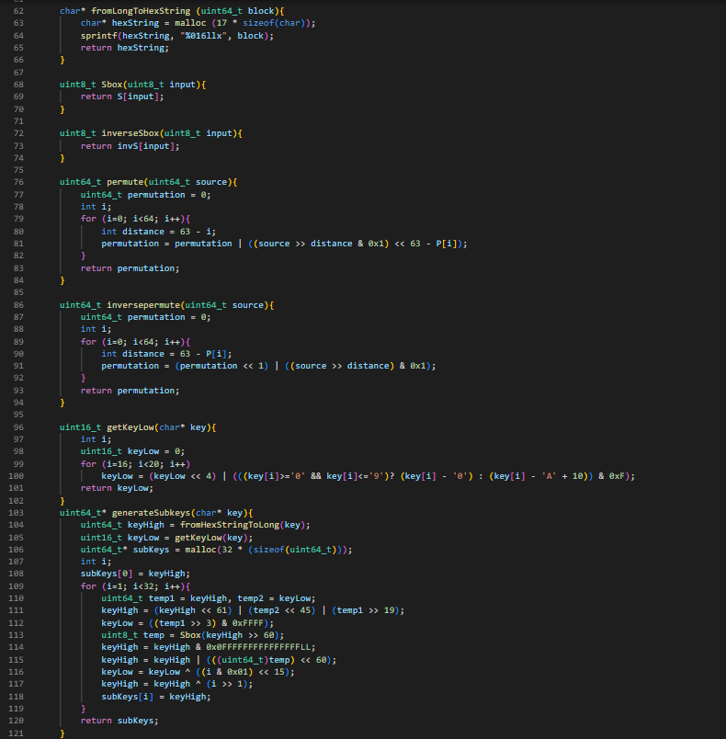
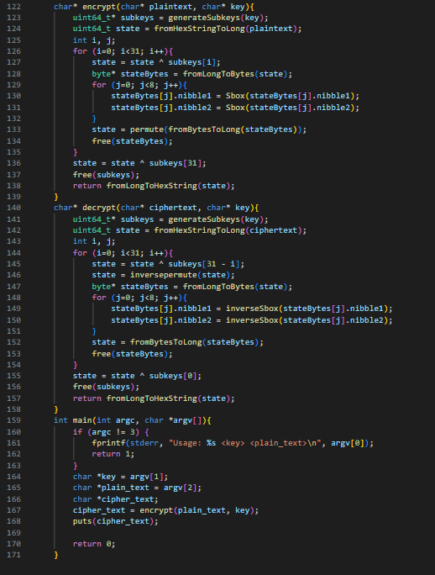
Present.c

Slide 13
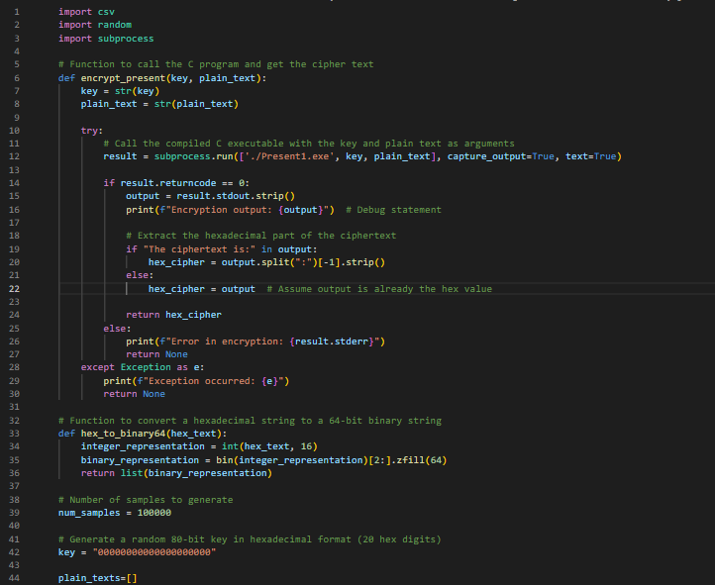
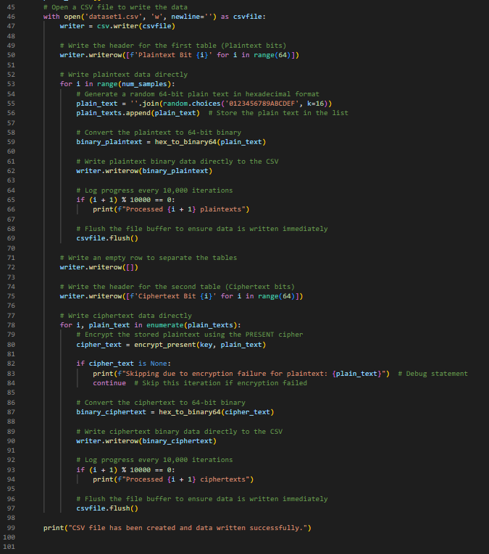
Dataset.py

Slide 14
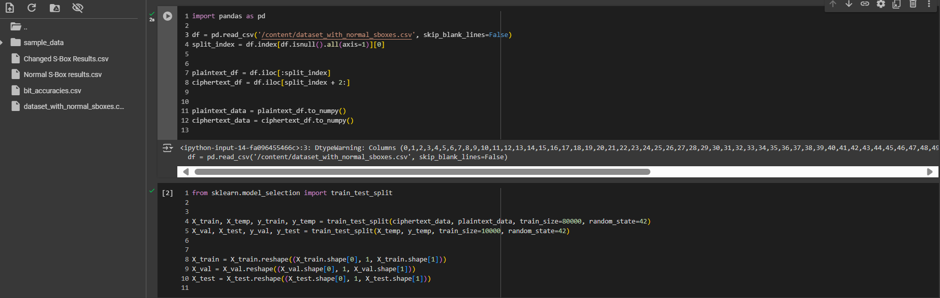
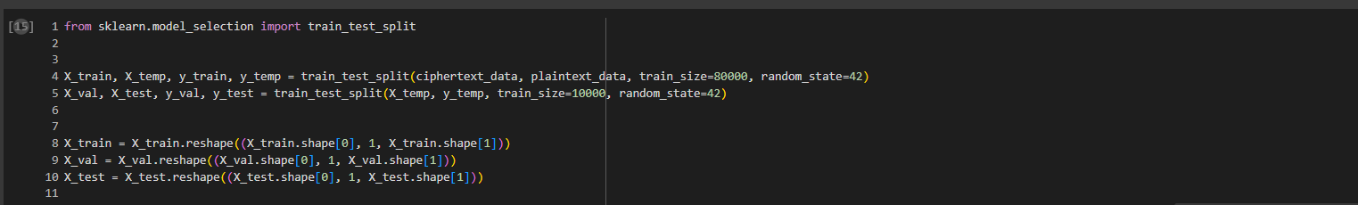
LSTM model

Slide 15
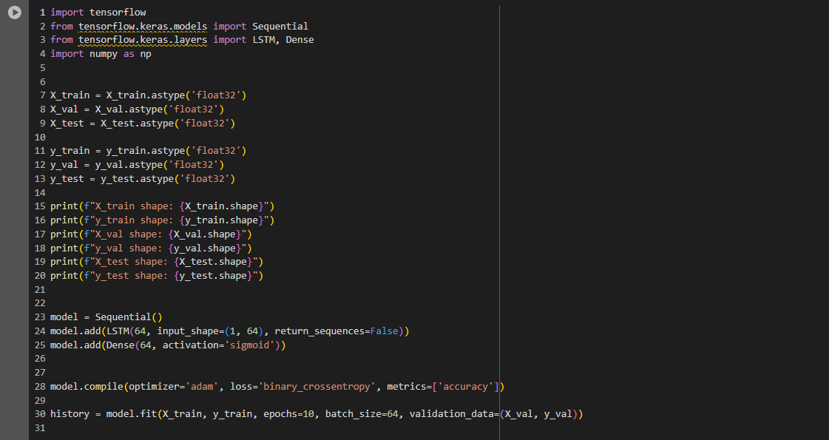
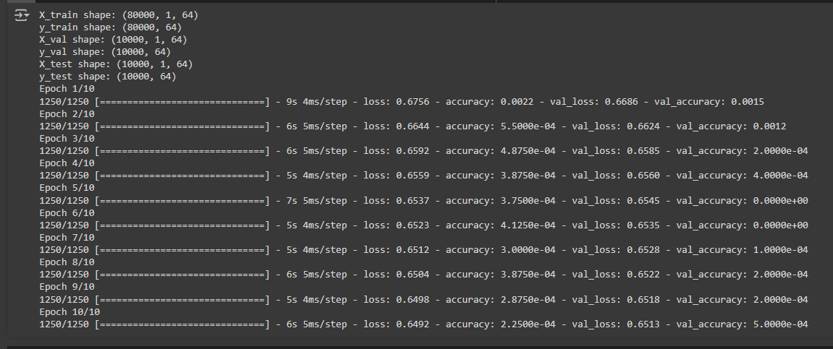
LSTM model (continued)

Slide 16
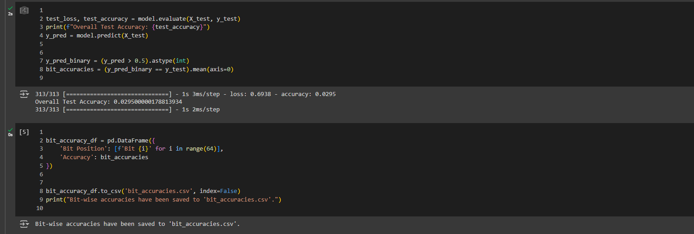
LSTM model (continued)

Slide 17
Thank you

